Slide 1

Excellence Beyond Expectation
KIT-Kalaignarkarunanidhi Institute of Technology
Accredited with 'A' Grade by NAAC
Kannampalayam Post,Coimbatore-02

Slide 2

IOT BASED SMART HOME
Prepared by
C.Balakumaran
A.Deepan
I.yasir
M.Hariharan

Slide 3
Introduction:
A simple definition for home automation is the ability to do tasks automatically or change remote status automatically.
Common tasks include turnoff lights when no one in Room,locking door via smartphone,automatic air conditioning system that can sense and memorize the temperature settings and appliances that help you to reduce the time.

Slide 4
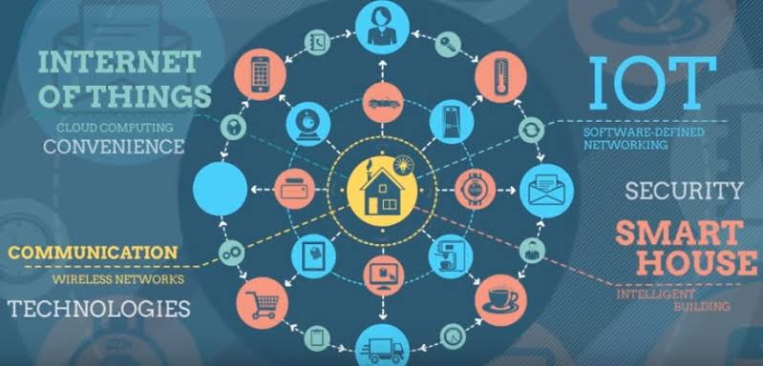
Internet of things:
The main objective of this project is to build Smarthome device which can be used to control the home appliances via internet.
This establishes the internet connection to the system and all the home appliances can in turn be connected and controlled by internet.

Slide 5
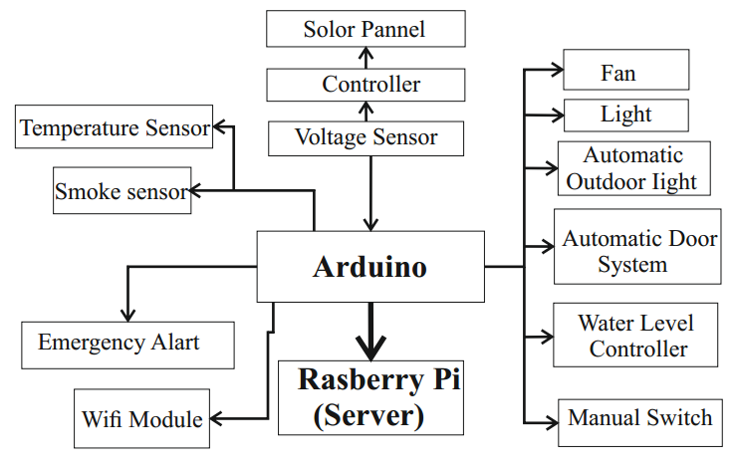
Block diagram:

Slide 6
Project description:
Arduino uno:The digital and analog input/output pins are equipped in boards that may be interfaced to various expansion boards and other circuits.Serial communication interface is a feature in this board including USB.
Voltage regulator: It is used to maintain a constant voltage level and also used for regulating AC or DC voltages.A voltage regulator contain negative feedback and feedforward design control.
Wi-Fi module: It is generally used to establish wireless communication between the devices.

Slide 7
4.Sensors:
Temperature sensor
smoke sensor
Proximity sensor
Motion sensor
water level sensor
vibration sensor
weather sensor

Slide 8
5.solarpanel:
Photovoltaic solar panels absorb sunlight as a source of energy to generate electricity. A photovoltaic (PV) module is a packaged, connected assembly of typically 6x10 photovoltaic solar cells. Photovoltaic modules constitute the photovoltaic array of a photovoltaic system that generates and supplies solar electricity in commercial and residential applications.

Slide 9
Kit required:
Arduino uno
Raspberry pi
Wi-Fi module
Manual switchs
Sensors
Programming language: Arduino programming (C++).

Slide 10
References: 1.Home Automation Using WiFi(Atmega32p) (International Journal of Advance Research in Engineering, Science & Technology) 2.Home Automation using Raspberry Pi 2 (International Journal of Current Engineering and Technology)

Slide 11
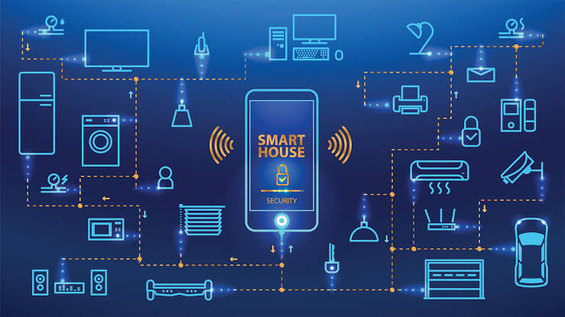
THANK YOU

